Slide 1



National Clothing Chain Market Analysis Report
View in Power BI
Last data refresh:
12/29/2023 8:55:41 PM UTC
Downloaded at:
12/29/2023 9:05:04 PM UTC

Slide 2
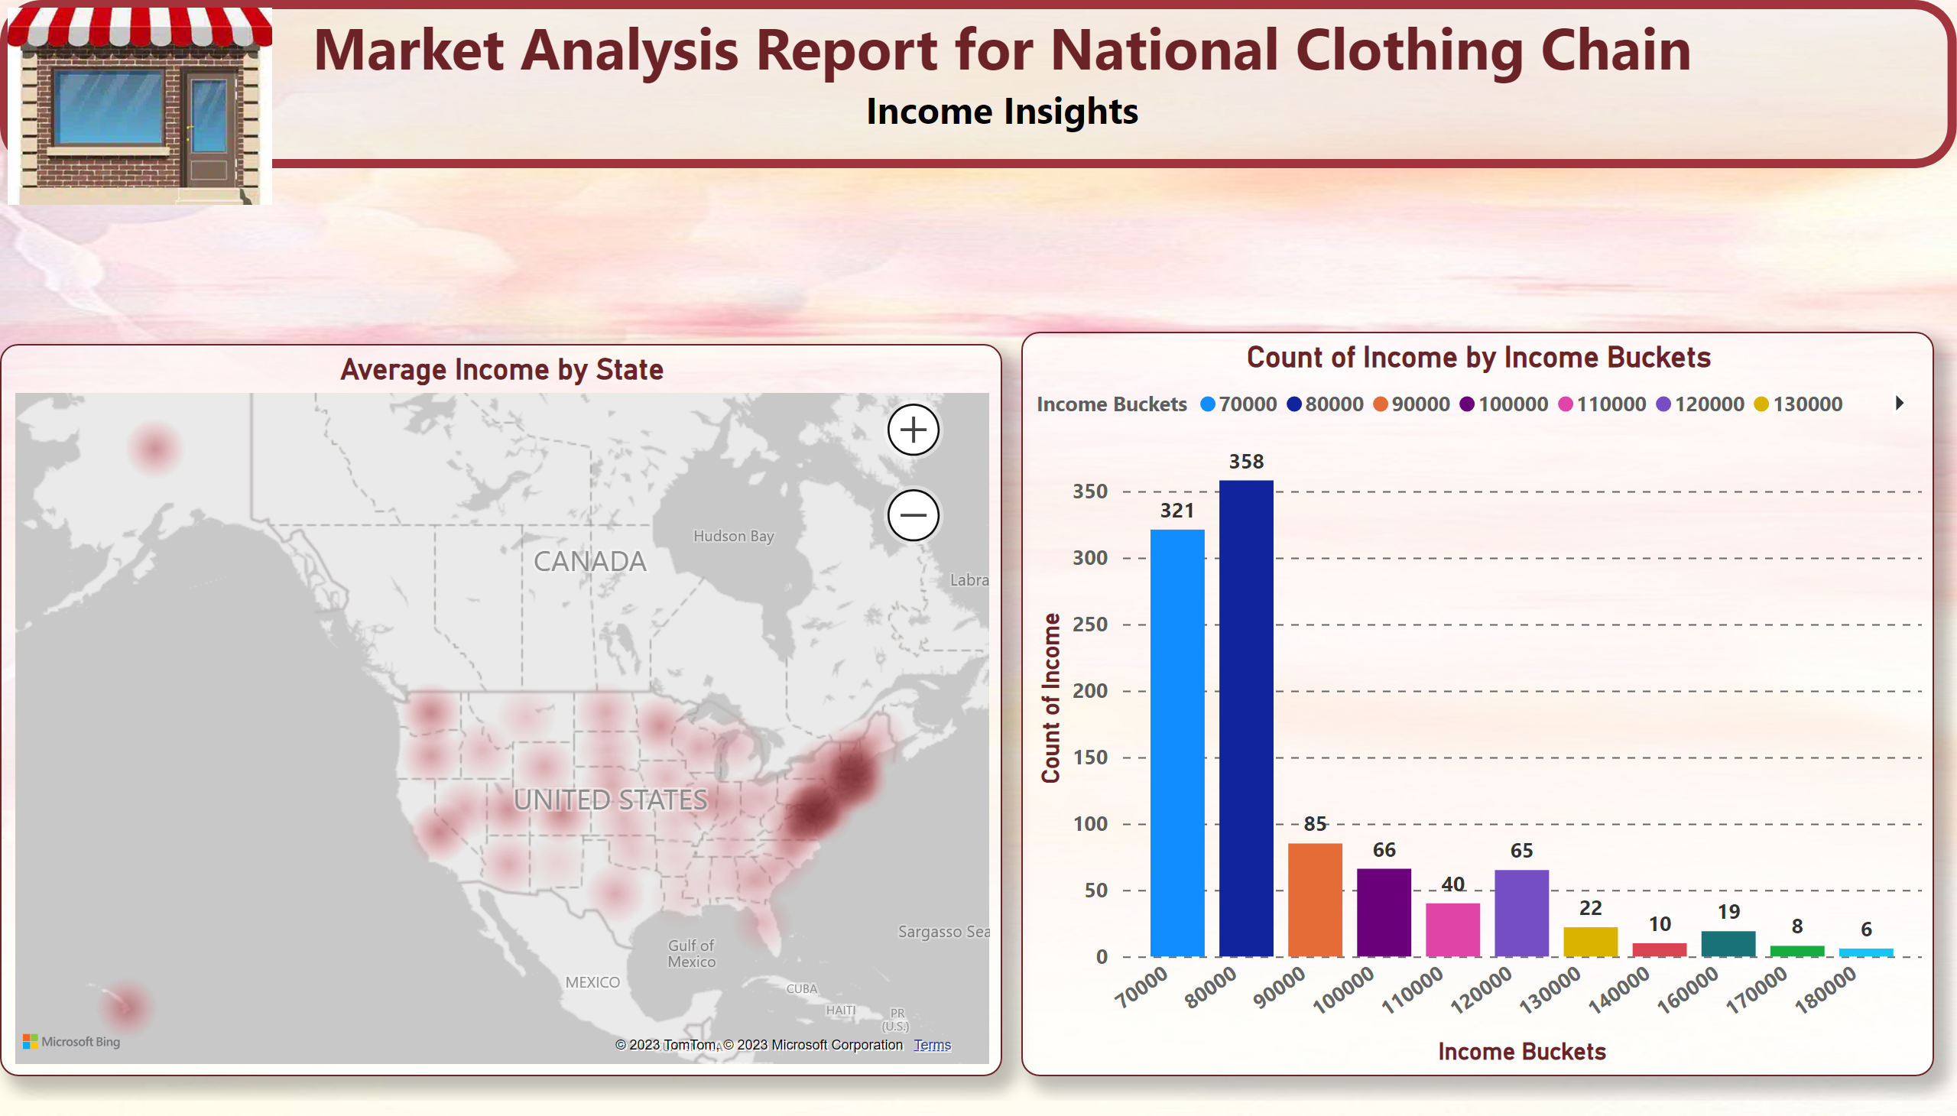
Page 1
Notes:
Average Income by State
No alt text provided
Count of Income by Income Buckets
No alt text provided
textbox
No alt text provided
shape
No alt text provided
image
No alt text provided

Slide 3
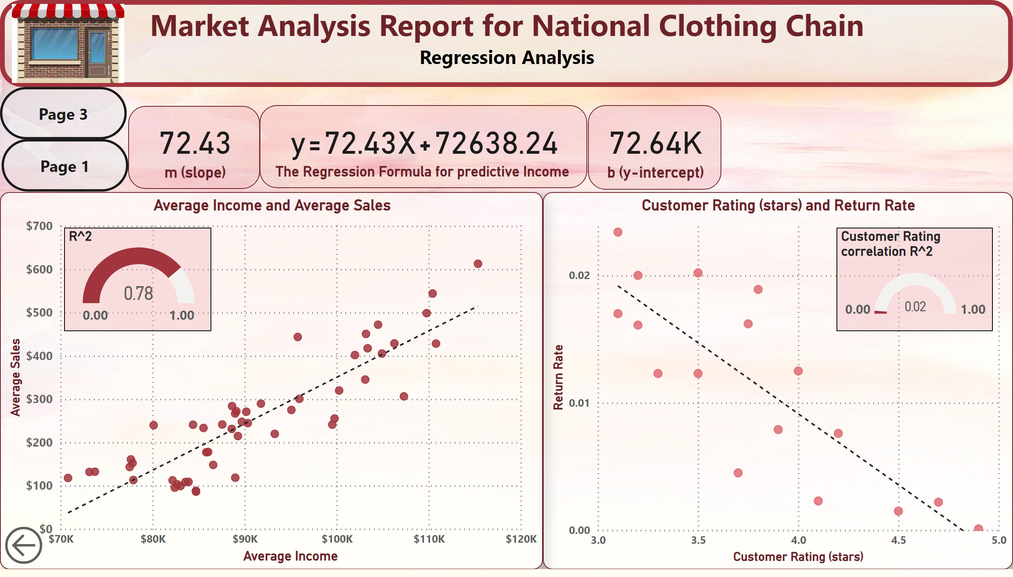
Page 2
Notes:
Average Income and Average Sales
No alt text provided
scatterChart
No alt text provided
shape
No alt text provided
card
No alt text provided
card
No alt text provided
card
No alt text provided
actionButton
No alt text provided
actionButton
No alt text provided
actionButton
No alt text provided
image
No alt text provided
textbox
No alt text provided
gauge
No alt text provided
gauge
No alt text provided

Slide 4
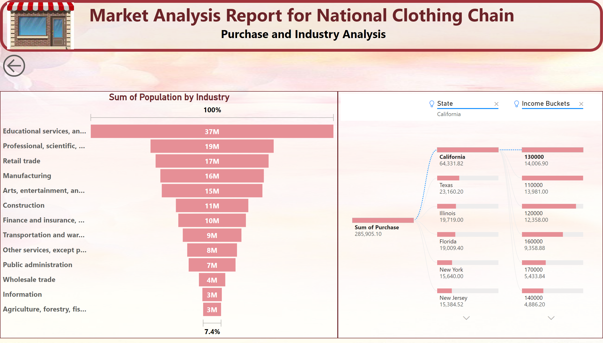
Page 3
Notes:
shape
No alt text provided
textbox
No alt text provided
funnel
No alt text provided
image
No alt text provided
decompositionTreeVisual
No alt text provided
actionButton
No alt text provided

Slide 5
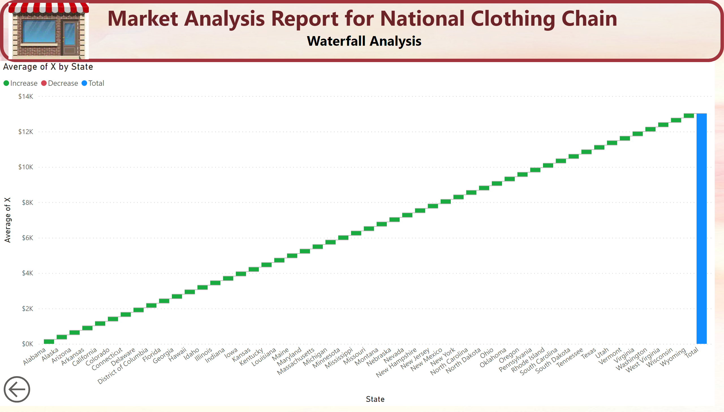
Page 4
Notes:
waterfallChart
No alt text provided
shape
No alt text provided
textbox
No alt text provided
image
No alt text provided
actionButton
No alt text provided

Slide 6

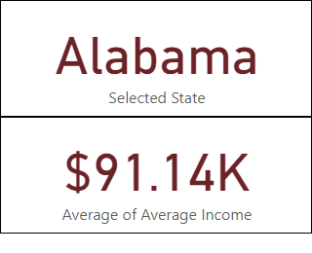
Page 5
Notes:
card
No alt text provided
card
No alt text provided

